Slide 1
General meeting 03.11.2022
Sjur Beyer

Slide 2
Contents/motivations
Second to last meeting of the semester
Status update

Slide 3
Progress
~1000 lines of code has been written
Many model runs have been done to test the model

Slide 4
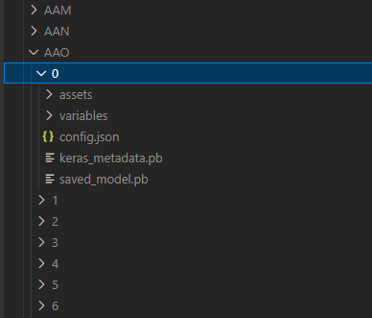
Folder structure
Tree letters denoting group name
Total 26^3 = 17 576 combinations
Models are given a number starting at 0
A model name will then be Groupname / Modelnumber

Slide 5
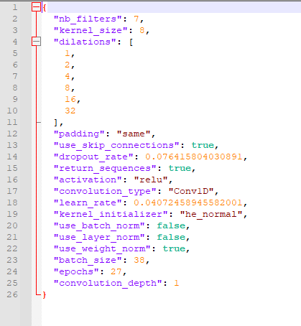
Model configs
These are saved in the .json file
These parameters get tweaked by optuna, so I save them to be able to compare what the good performing models have in common
Planning to add ‘feat_aug_dataset’ to have optuna decide what additional data preprocessing is preferable

Slide 6
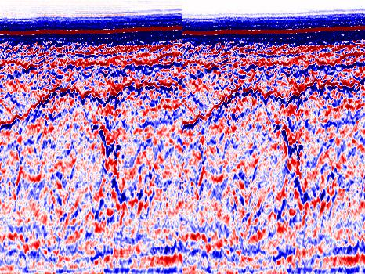
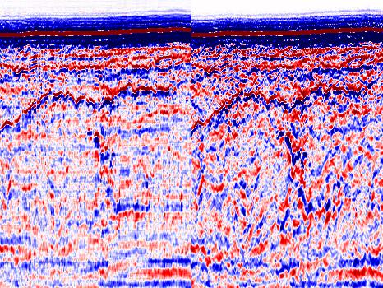
Reconstruction

Slide 7
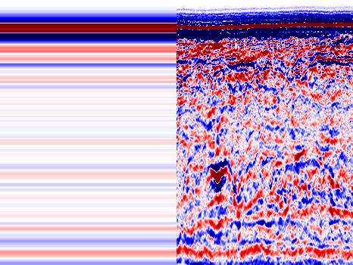
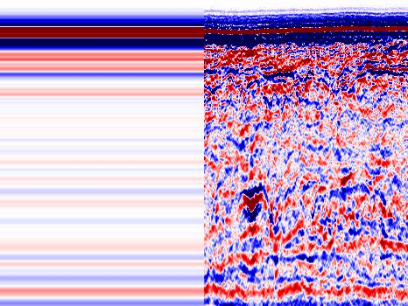
Not just a kernel size issue (these had ks=8)

Slide 8
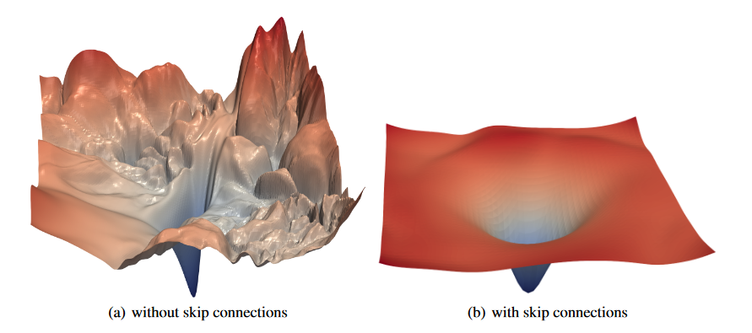
Errors might just be bad regions of loss landscape

Slide 9

Profiling
Where is the code running | Time per step [ms/step]
NGI Laptop | ~270
Odin w/ # users = ? | ~587
Odin w/ # users = 2 | ~360
Desktop with RTX A2000 | ~35*
* This was running the model with much longer traces and also multiple outputs

